Slide 1
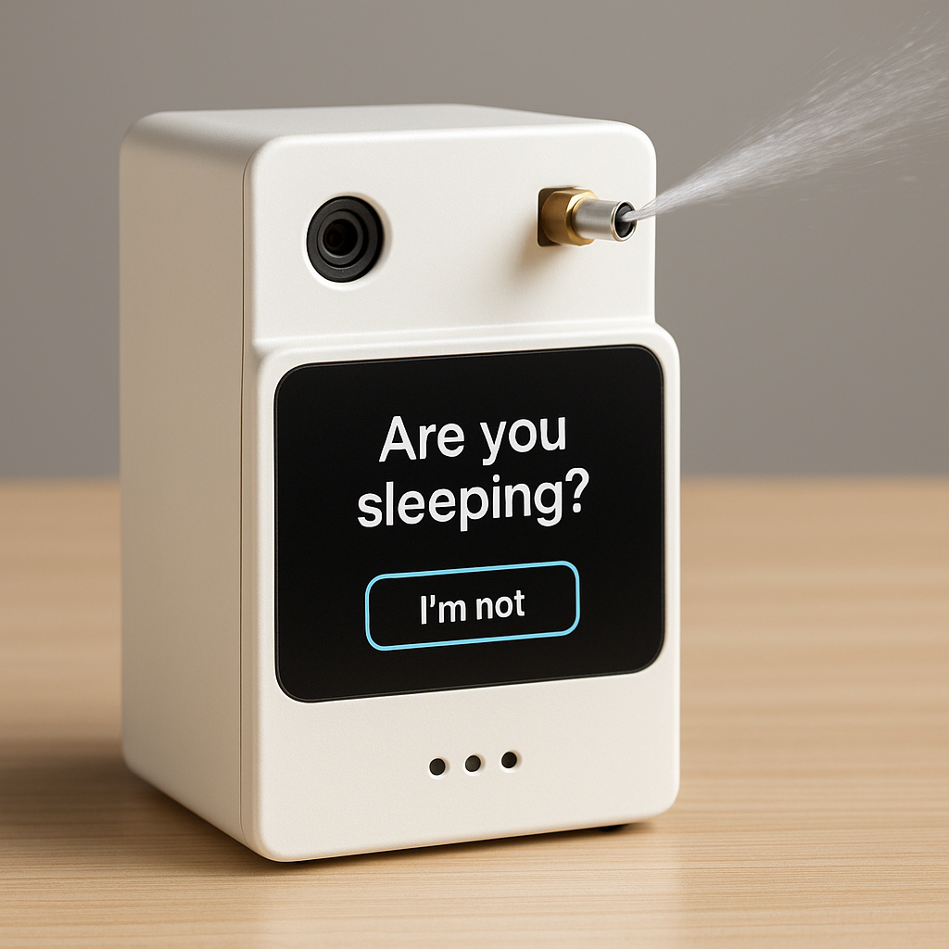
Wake-Up Machine
RJ, Ken, Keito, Harry

Slide 2

Problem
Staying focused while studying is hard, especially when you’re sleepy.

Slide 3
Solutions
Detects if the user is present
Asks, “Are you sleeping?” when the eyes are closed
If no response in 1 minute, it sprays water to wake you up

Slide 4
Key Features
water spray
camera
speaker

Slide 5
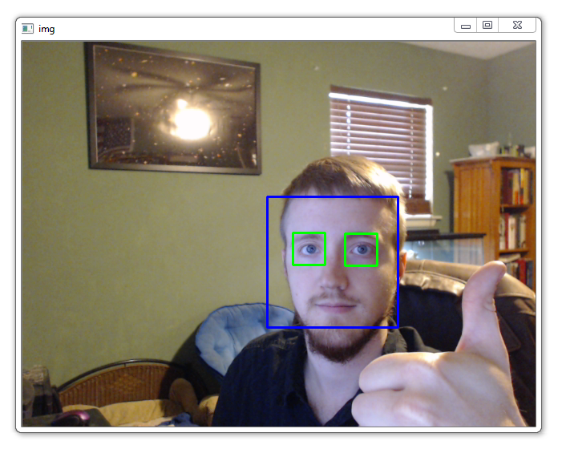
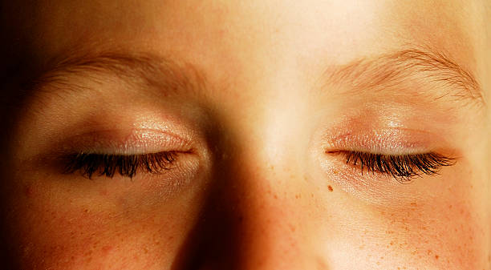

Demo Flow
Detects user is present by camera (OpenCV)
Asks “Are you sleeping” (TTS) when the user’s eyes are closed
Waits for a minute
If no response, sprays water so that user can focus on studying

Slide 6
Tech Stack
OpenCV : Recognizes the face and eyes
TTS : Asks user is sleeping
Timer: Check the eyes are closed, and set 1 minutes to check response

Slide 7
Thank You!

